Slide 3
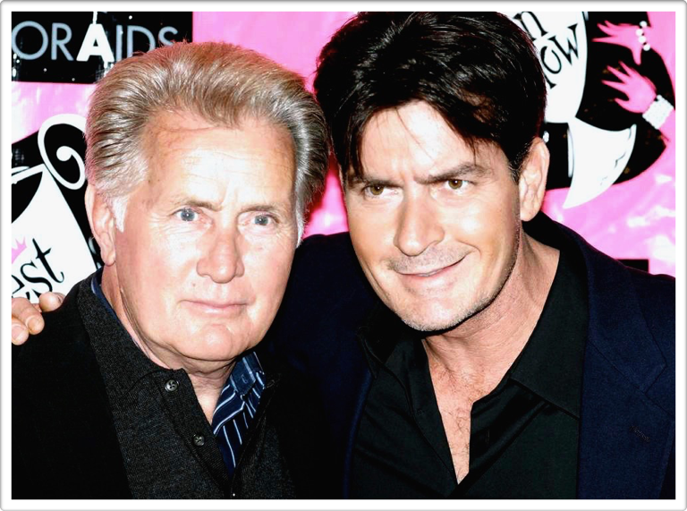

Slide 4
THE HISTORY OF THE ISRAELITES
Jacob died the death of the righteous in Egypt (Hebrews 11:13, 22)
Joseph and the Israelites were strong in Egypt (Exodus 1:1-7)
Another Pharaoh came to power who did not know Joseph (Exodus 1:8-22)

Slide 5
THE HISTORY OF THE ISRAELITES
Taskmasters were set over the Israelites to afflict them with burdens
The Israelites were horror-stricken when the message was decreed
The midwives feared God and did not do as the king commanded

Slide 6
THE PARENTS OF MOSES
Three very renowned children were born to them (Numbers 26:59)
Slaying the male children was in force when Moses was born (Exodus 2:1-10)
Miriam asked Pharaoh’s daughter if she could get a Hebrew nurse

Slide 7
THE PARENTS OF MOSES
TIPS FOR DISCIPLINE
Clearly communicate instructions to your child
Confront the child when disrespect is shown
Send the child to a “punishment room”
Stress that the child is responsible for what happens
Spank the child
Tell the child that you love them
Forget the episode and return to normal
LIFE-CHANGING SUBJECTS CHILDREN NEED TO HEAR
Seek God’s kingdom first (Matthew 16:24-26)
Worship God in spirit and truth (John 4:24)
Maintain moral purity (2 Timothy 2:22)
Marry a spiritually-minded person (1 Kings 21:25)
Be responsible for choices and actions (Ezekiel 18:26)
They got to train their child for his great destiny (Exodus 3:10)
They filled his mind with love for his people and reverence for God
He later stood true to the teachings of his parents (Hebrews 11:25-26)

