Slide 2
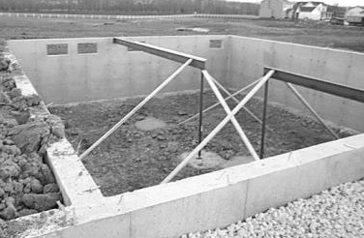
A book of beginnings
Meaning of anything is tied to its origin
A “foundation” for the rest of Scripture
A basis or support
A foundational principle
A foundation for a house

Slide 3
GENESIS
Every NT Writer References Genesis
Nearly Every NT Book References Genesis
Over 100 passages in NT Reference Genesis
“If the foundations are destroyed, What can the righteous do?”
(Psalm 11:3)

Slide 4
Jesus
Creation
Flood
Sodom
Apostles
Creation
Male Female
Adam Eve
Flood
Sodom
“If the foundations are destroyed, What can the righteous do?”
(Psalm 11:3)

Slide 5
What About This?
If Corrupt?

Slide 7
The Value of Genesis

Slide 8
To Understand God’s Word
2 Timothy 3:15, 16
John 5:46, 47
Jesus and Genesis (Gen. 3:15; 22:18; 49:8-12)
tied
JESUS
GENESIS

Slide 9
To Understand God’s World
SIN—THE PROBLEM
Enmity and conflict (Gen. 3:15; Gen. 4)
Suffering (Gen. 3:16)
Toil/sorrow (Gen. 3:17, 18; Gen. 5:29)
Death (Gen.3:19; 5:5ff)
Wild and dangerous animals (Gen. 1:30; 9:2-5)
Confusion (Gen. 11)

Slide 10
To Understand Important Doctrines
The meaning of something is tied to its origin
Genesis provides information about origins
Genesis provides meaning
Marriage
Clothing
Life and Death
Headship & Submission

Slide 11
To Understand Our Soul’s Adversary
A cunning serpent—suggestive questioning
Attacks God’s word—brings contradictions
Attacks the God’s character
Appeals to our pride
2 Corinthians 11:3

Slide 12
Lessons From The Very First Verse!

