Slide 2
GENESIS
Every NT Writer References Genesis
Nearly Every NT Book References Genesis
Over 100 passages in NT Reference Genesis
“If the foundations are destroyed, What can the righteous do?”
(Psalm 11:3)

Slide 4
Lessons From The Very First Verse!

Slide 5
“In the Beginning”
Time
Time as we know it had a beginning (Titus 1:2)
One of the dimensions of our universe
May only move forward in but identified in three ways:
Past (remember)
Present (experience, live in)
Future (anticipate, fear, hope)

Slide 6
“God”
NOT “in the beginning God was created”
God existed before the beginning (time)
“God’ (Heb. Elohim) teaches a plurality of persons in God
The Triune God
John 17:5; 20:17; Heb. 1:8, 9; Matt. 3:17; Heb. 1:1, 2; Jn. 5:23; Gen. 1:2; Acts 5:3, 4
Father
Son
Holy Spirit

Slide 7
“Created”
Tells of the original energy source for the creation—the infinite power of God!
Hebrew “bara” found three times (Gen. 1:1, 21, 27)
Signifies the creation of something which previously did not exist
Material substance (1:1)
Living substance (1:21)
Imperishable substance (1:27)

Slide 8
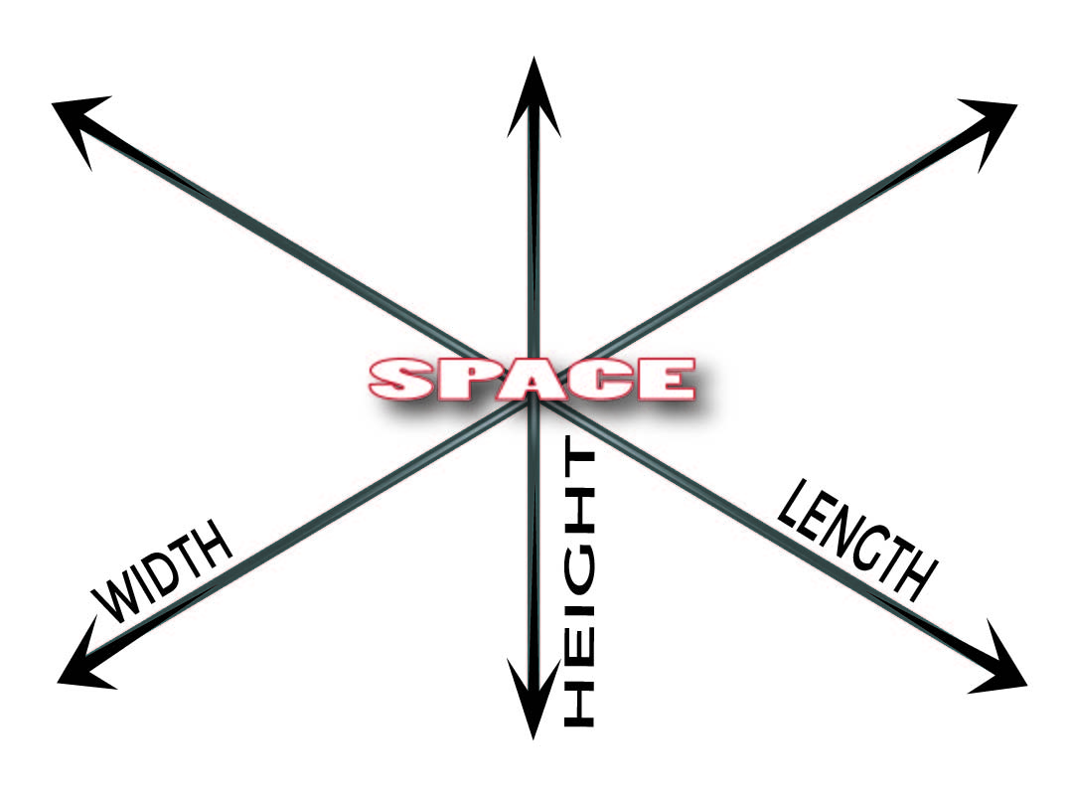
“The Heavens”
Space
Not nothingness
One of the dimensions of our universe
Observed in three dimensions
Idea of stretching out the heavens (Is. 40:22)

Slide 9
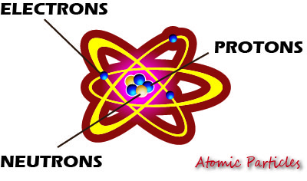
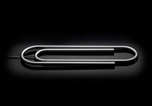
“And The Earth”
Matter
The way the universe functions may serve as a signature from the Creator
Hebrews 1:3
Romans 1:18-20
How Much energy would be released if every atom were split?

Slide 10
The Answer of “God!”
Solves the riddle as to “how” and “why” the universe came into existence
Nature cries out that there was a beginning
Nature alone does not answer how the beginning began—resulting in endless speculation
Bible answers that the beginning began with an eternal God

Slide 11
What is the Relationship Between God and the Dimensions of Nature?

Slide 12
Time
As creator of time, God is over and outside of it
“Behold, God is great, and we do not know Him; Nor can the number of His years be discovered” (Job 36:26)
2 Peter 3:8

Slide 13
Space
Since God created space, He can know what happens everywhere in the universe
“‘Can anyone hide himself in secret places, So I shall not see him?’ says the LORD; ‘Do I not fill heaven and earth?’ says the LORD’” (Jer. 23:24).

Slide 14
Matter
God’s nature is superior to matter
“God is Spirit, and those who worship Him must worship in spirit and truth” (Jn. 4:24)
Seen in the prohibition to make images (Deut. 4:15ff)
Seen in the insufficiency of dwelling in a temple made with hands (Acts 17:24)

Slide 15
While the universe and everything in it needed a beginning, God does not
Asking “Who created God” would be as silly as asking “Who created the Creator?”
Only the answer of a Creator-God can solve the riddle as to “how” and “why” the universe exists

