Slide 2
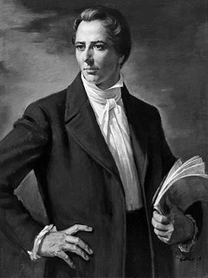
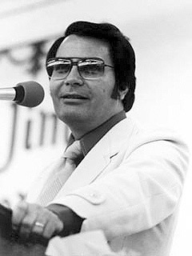
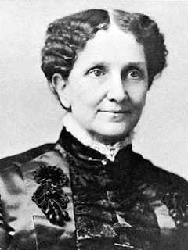
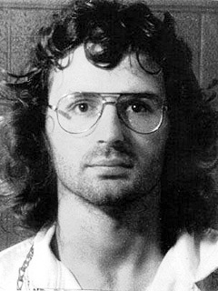
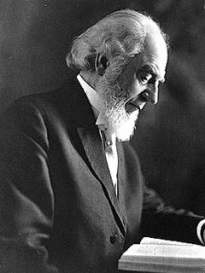
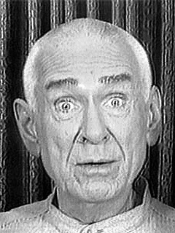

Slide 4
What Is A Cult?
The idea is in the Bible in seed form
Hairesis or “sect” which means “to choose” (cp. Acts 5:17; 15:5; 24:5; 26:5; 28:5)
Some definitions are too broad
“System of religious veneration and devotion directed toward a particular figure or object”

Slide 5
Characteristics Of Cults
Exalt a charismatic leader
Deny the Bible as the sole source of authority
Practice isolationism
Subordination of one’s life to control of cult

Slide 6
Denominationalist’s View Of Cults
Denominationalist adds characteristics:
“Works salvation/legalism”
“No assurance of salvation”
“Denunciation of other groups”

Slide 7
What Proves Too Much Proves Nothing!
Denominationalists Say:
Condemn those who disbelieve
(Muslims, Buddhists, etc.)
Demand a strict code of conduct (dress, speech, recreation, etc.)
CULT
CULT

Slide 8
Why Do People Join Cults?
Low self-esteem
Curiosity
Rebellion
Going through a difficult time
Lack of strong morals/values
Lack of Bible knowledge

Slide 9
What Can I Do To Help Someone?
Carefully expose the hypocrisy of the cult
Demonstrate genuine interest as a person
Show unprejudiced and learned love
Patiently break the mental/emotional chain

