Slide 1
Is There Really A God In Heaven?

Slide 2
"You are My witnesses," says the LORD, "And My servant whom I have chosen, That you may know and believe Me, And understand that I am He. Before Me there was no God formed, Nor shall there be after Me.
Isaiah 43:10

Slide 3
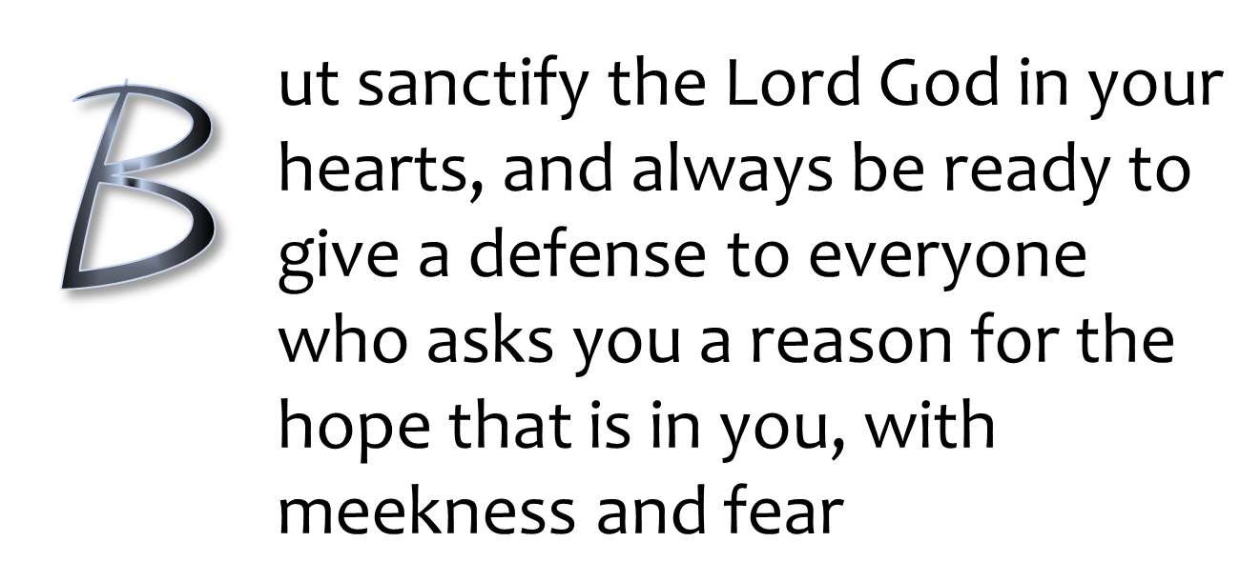
1 Peter 3:15

Slide 4

FAITH?
Is There Really A God In Heaven?
All verses are from the NKJV unless noted.

Slide 5
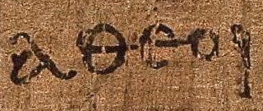

What Is An Atheist?
“that at that time you were without Christ, being aliens from the commonwealth of Israel and strangers from the covenants of promise, having no hope and without God in the world”
(Eph. 2:12)
“atheists”
The Greek word αθεοι (atheoi), as it appears on Papyrus ⁴⁶ in Paul’s epistle to the Ephesians 2:12
(c. 175-225 AD)

Slide 6
What Is An Atheist?
Originally understood as those who lived without God, the godless
Not knowing or worshipping God
Deny the existence of Deity
Incorrectly used today by some as “lack of belief in God”
“atheists”
The Greek word αθεοι (atheoi), as it appears on Papyrus ⁴⁶ in Paul’s epistle to the Ephesians 2:12
(c. 175-225 AD)

Slide 7

What Is An Atheist?
Incorrectly as “lack of belief in God”
  Is this a group of atheists?
“atheists”
The Greek word αθεοι (atheoi), as it appears on Papyrus 46 in Paul’s epistle to the Ephesians 2:12 (c. 175-225 AD)

Slide 8
Misunderstanding Faith
FALSELY ASSERTED: “Anything can be proven by ‘faith’ so ‘faith’ is futile in proving anything.”
  The “proof” of a good business venture is not simply because it is believed to be good
  The “proof” that there is a God is not simply because it is believed there is a God

Slide 9
Nature of Faith
“Now faith is the substance of things hoped for, the evidence of things not seen” (Heb. 11:1)
FAITH
substance/evidence
THE UNSEEN
“let us draw near with a true heart in full assurance of faith…” (Heb. 10:22)
most certain confidence

Slide 10

Evidence & Faith
    “but if I do, though you do not believe Me, believe the works, that you may know and believe that the Father is in Me, and I in Him” (Jn. 10:38)
Works
Evidence
Know & Believe
Knowledge of Evidence
Father In Christ
The Faith From The Evidence

Slide 11
Evidence & Faith
How can a person believe and love someone he has not seen?
  “whom having not seen you love. Though now you do not see Him, yet believing, you rejoice with joy inexpressible and full of glory” (1 Pet. 1:8)
unseen
believed
loved

Slide 12
Evidence & Faith
unseen
believed
loved
Evidence Had To Be Presented
PREACHING
(1 Pet. 1:25; Rom. 10:17)
CREDIBLE TESTIMONY
(2 Pet. 1:16-21)

Slide 13

Scientism
“Belief in the unseen is weird…why should I believe in God? Praying to something “unseen” is loony.
I won’t believe anything unless I can see it.”
Yet these believe in evolution without seeing it!

Slide 14
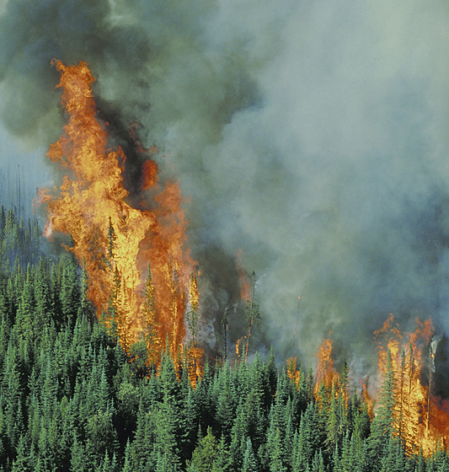
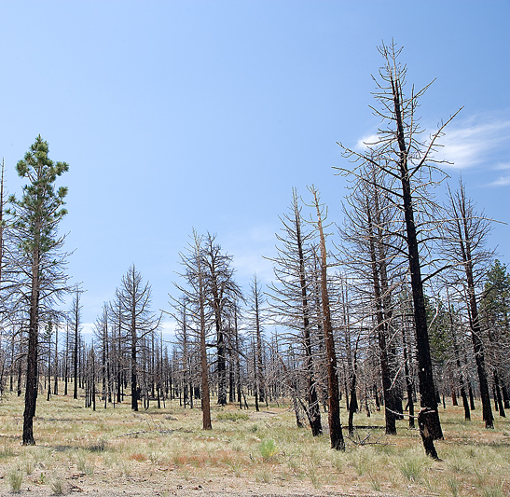
Seeing the Unseen
I Don’t Have To See The FLAMES
To Know They Were In This FOREST

Slide 15
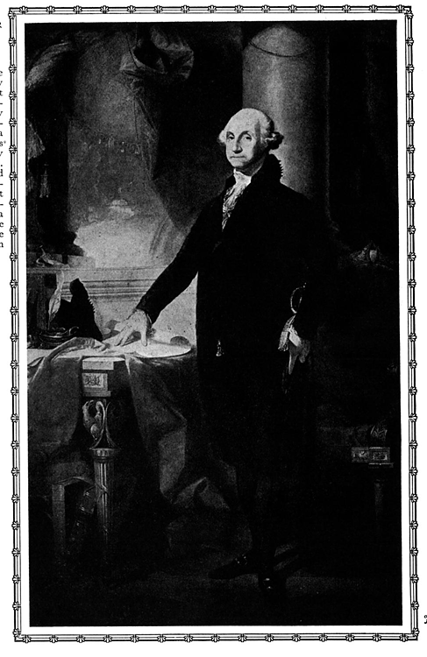
Do You Believe In George Washington?
Do you believe he was our first president?
Do you believe he even existed?
  Have you seen him?
  Have you heard him?
  Have you talked with him?

Slide 16
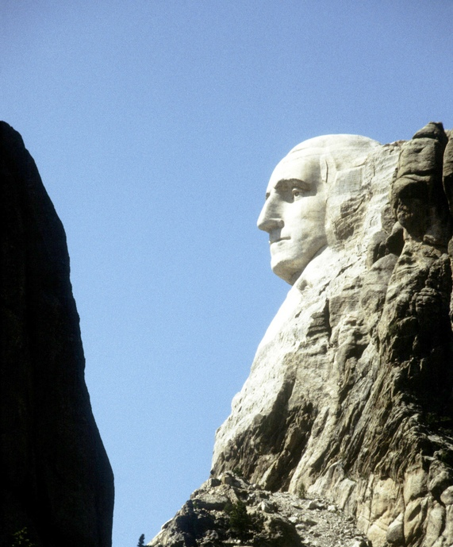
Do You Believe in Mount Rushmore?
Do you believe it is real or a fabrication?
If you believe it real…
  Do you believe it was given to us by aliens?
  Do you believe it was the product of erosion?
  Do you believe it was the product of random and violent explosions?
  Do you believe it was designed by intelligence?

Slide 17
Is
There
A God
!
?
“But there is a God in heaven who reveals secrets, and He has made known to King Nebuchadnezzar what will be in the latter days….” (Dan. 2:28).

Slide 18
Yes There Is A God In Heaven!
From Prophecy (Dan. 2:28)
“(as it is written, ‘I have made you a father of many nations’) in the presence of Him whom he believed—God, who gives life to the dead and calls those things which do not exist as though they did”
(Rom. 4:17)
1
prophecy
2

Slide 19
Daniel (2:28)
Affirmed “There is a God’ because of the power to reveal dreams
Dream was revealed and interpreted
The dream’s revelation spoke of the rise and fall of four world empires and also establishing the kingdom of heaven (Dan. 2:44)
  The prophetic revelation has proven true in every detail

Slide 20
The Kingdoms In Daniel
Described as beasts
Babylon (lion)
Mede/Persian (bear)
Greece (leopard)
Rome (dreadful & terrible)
Son of Man’s kingdom
Daniel 7:1-3, 17
7:4
7:5 (cf. ram, 8:20)
7:6 (cf. male goat, 8:21, 22)
7:7, 23
7:13, 14

Slide 21
How Could Daniel know and describe four world empires?
How could Daniel foresee the coming kingdom of Christ?
ANSWER: “But there is a God in heaven who reveals secrets, and He has made known to King Nebuchadnezzar what will be in the latter days….” (Dan. 2:28).

Slide 22
Crucifixion of Messiah
King David wrote: “For dogs have surrounded
Me; The congregation of the wicked has enclosed Me. They pierced My hands and My feet” (Ps. 22:16)
  1000 years before Christ
  Hundreds of years before the act of crucifixion
  Dead Sea Scroll (4QPs^{f}) predates Christ’s crucifixion and verifies the boring through the hands and feet
Many other like prophecies could be studied!

