Slide 3
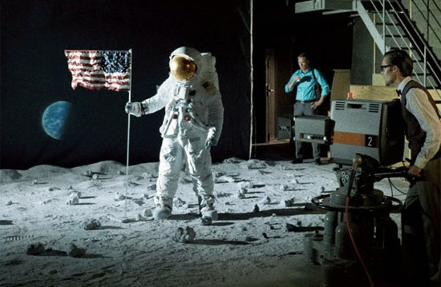

Slide 4
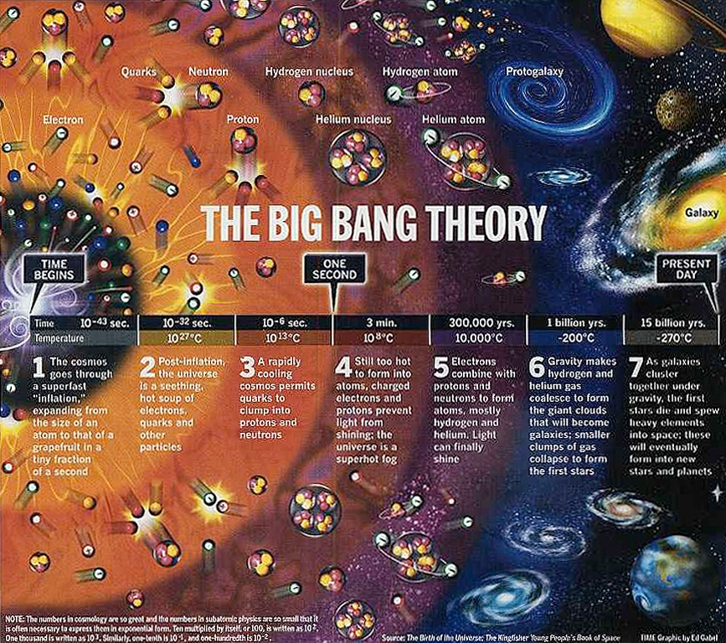
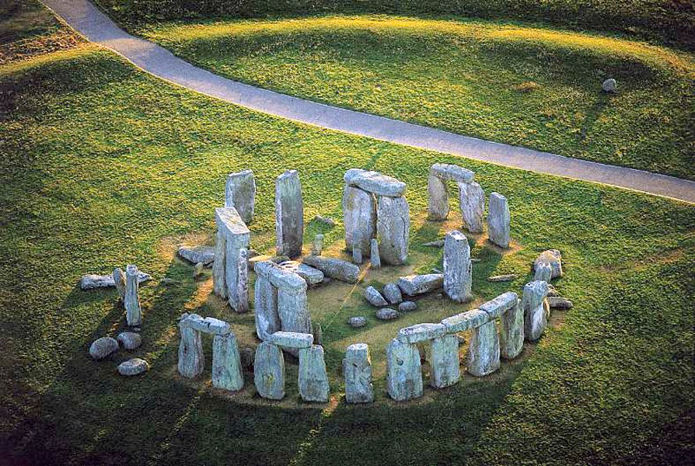
The Law Of Causality
The most universal, and most certain, of all scientific laws is the Law of Cause and Effect
We never observe anything coming into being without a cause
Many believe that eternal fragments came together in an unproven, spontaneous event
Christians affirm that God has always existed and He designed the Universe
“The Universe, and everything that has happened in it since the beginning of time, are a grand effect without a known cause. An effect without a cause? That is not the world of science; it is a world of witchcraft, of wild events and the whims of demons, a medieval world that science has tried to banish. As scientists, what are we to make of this picture? I do not know. I would only like to present the evidence for the statement that the Universe, and man himself, originated in a moment when time began.”
Robert Jastrow
“Every effect must have a cause. That is true by definition … It is impossible for something to create itself. The concept of self-creation is a contradiction in terms, a nonsense statement … Self-creation is irrational.”
R. C. Sproul
“We may only add that almost all philosophers regard the Law of Causality as the most important, the most far-reaching, and the most firmly founded of all principles of epistemology.”
Richard von Mises

Slide 5
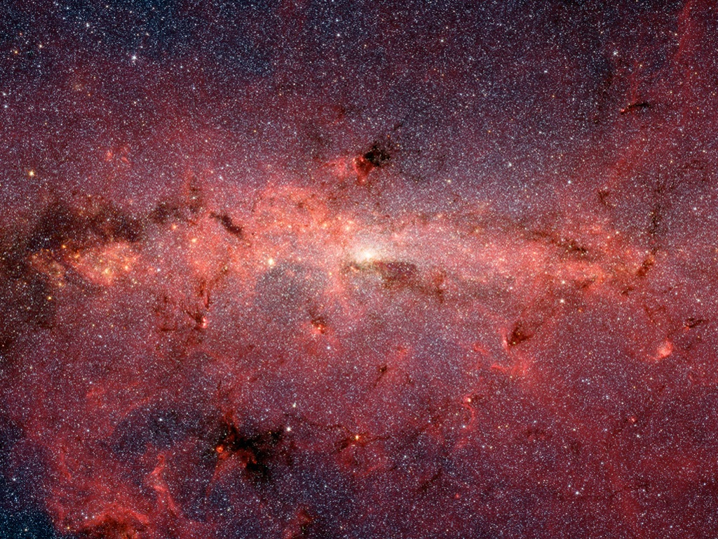
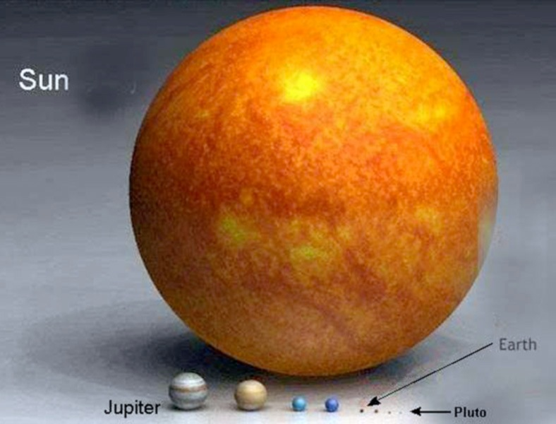
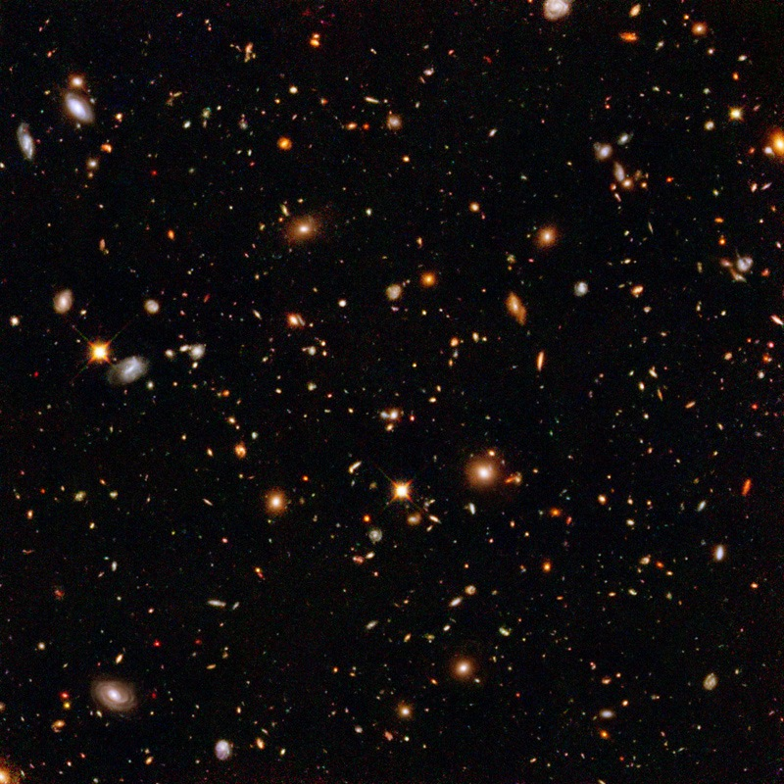
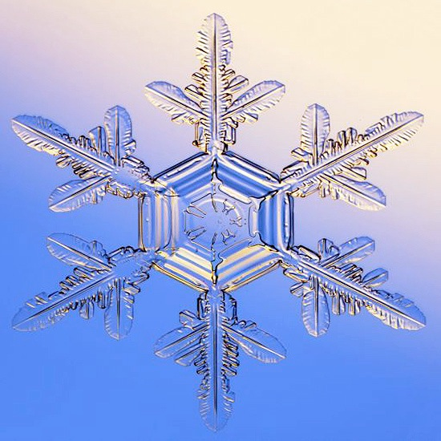
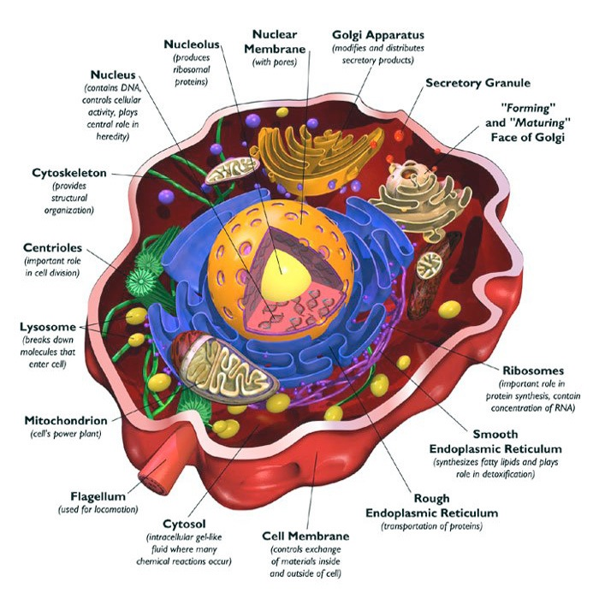
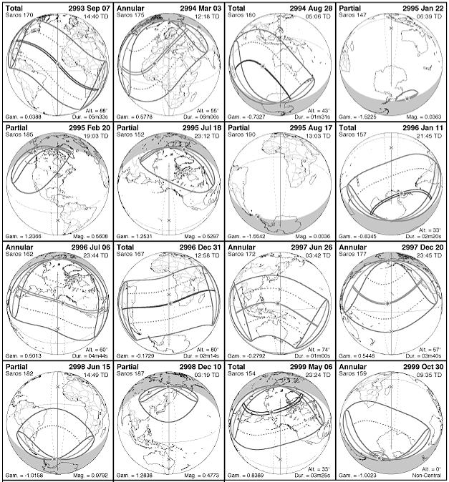
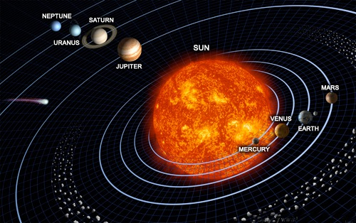
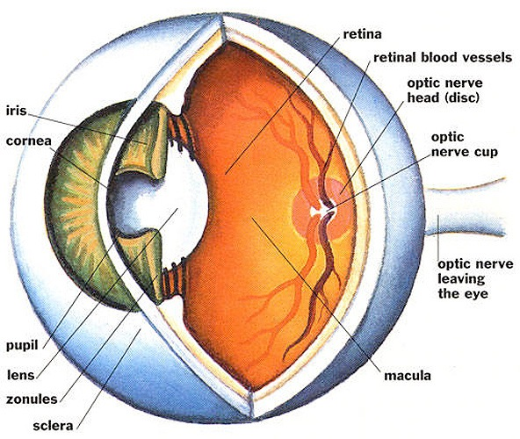
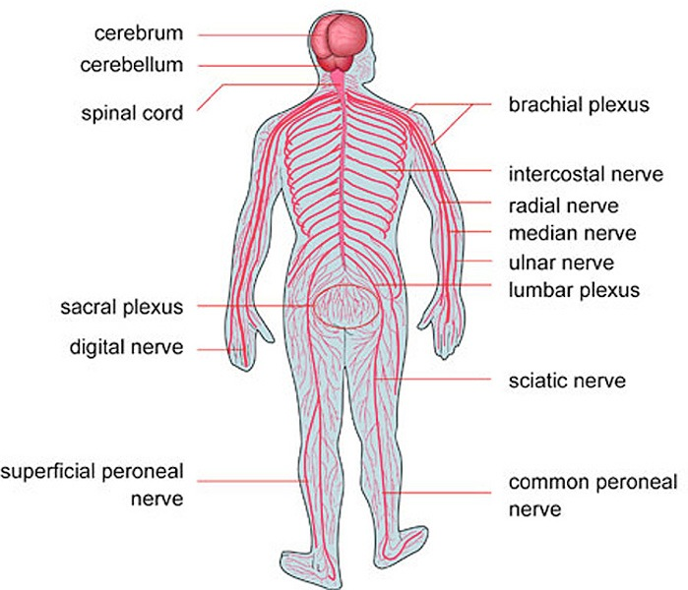
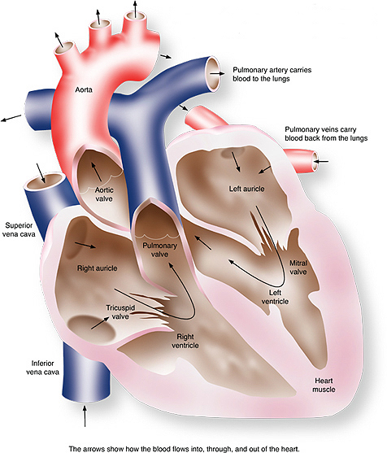
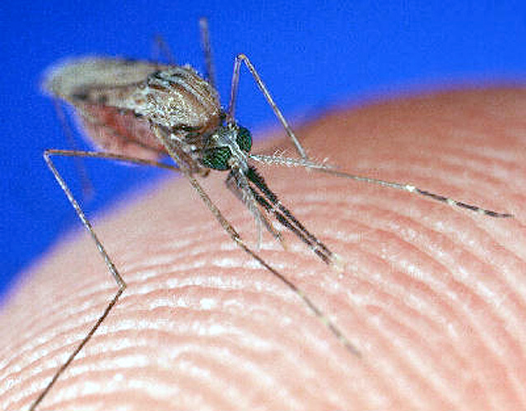
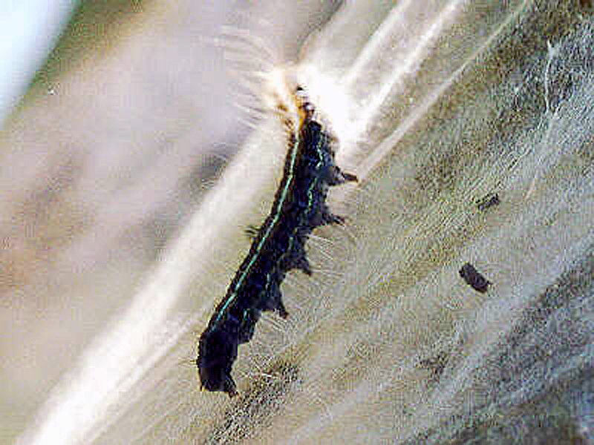
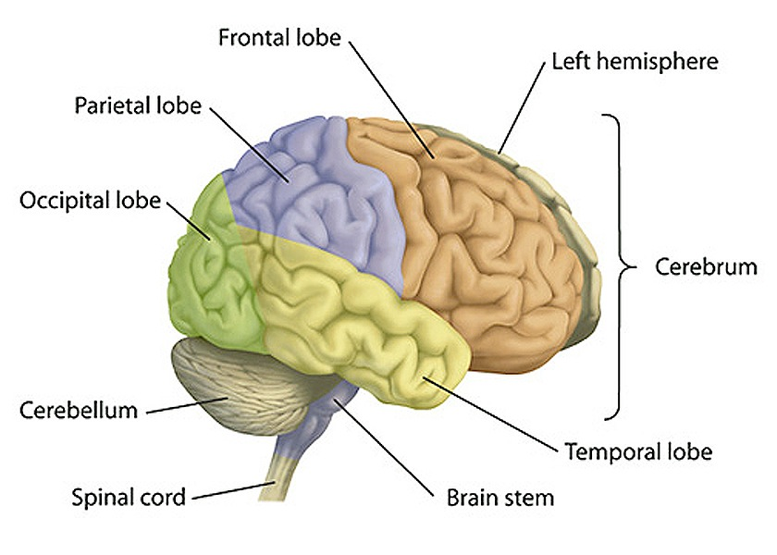
The Design And Purpose Of The Universe
Consider the design and purpose of the size and precision of the Universe
Consider the design and purpose of the complexity of the human body
Consider the design and purpose of the complexity of plant and animal life
Science is predicated on the proposition that the Universe is able to be understood
Since the Universe is run by laws, there is a Lawgiver
Since the Universe operates on mathematical principles, there is a Mathematician
Since the Universe is a masterpiece of engineering, there is an Engineer

Slide 6
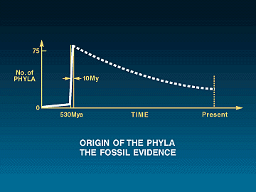
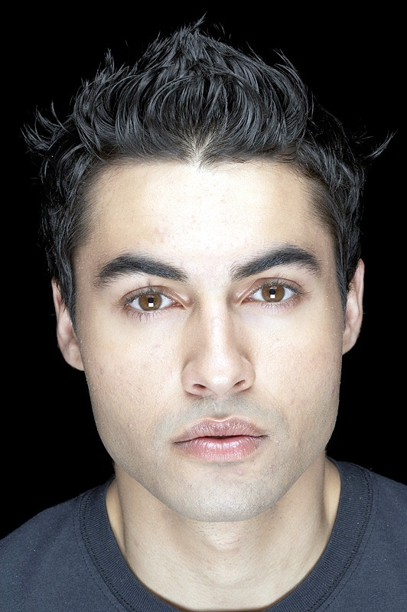
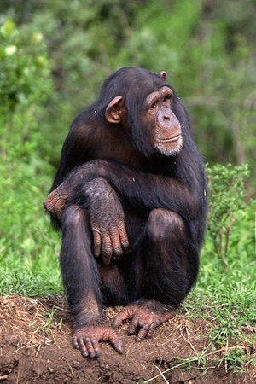
The Unique Nature Of Man
Characteristics Of Man
We are faced with two choices
Why we reject the theory of evolution
It is an unproven theory
It does not account for the origin of man
The “link” is mostly missing
Man possesses distinctive characteristics
Capacity for rational thought
Conscience and a sense of morals
Appreciation for art and beauty
Religious reflection and inclination
“On the other hand, it does appear to me that Darwin in the Origin was not able to produce palaeontological evidence sufficient to prove his views but that the evidence he did produce was adverse to them; and I may note that the position is not notably different today.”
W. R. Thompson
“The study of evolution has nothing to say concerning origins. When one goes beyond the observed changes and tries to trace the successions back to their source, he is in the region of speculation and outside the boundaries of science.”
Dr. John Coulter
“At the same time I think that the attempt to explain all living forms in terms of evolution from a unique source … is premature and not satisfactorily supported by present-day evidence.”
Dr. G. A. Kerkut

