Slide 2
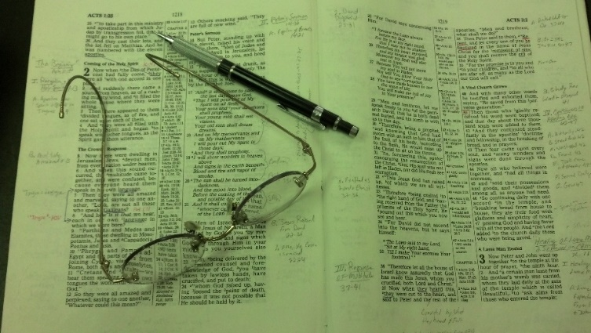
Topics
Sunday Class – Believing God
Sunday AM – Selling and Stirring
Sunday PM – The Peace of God
Monday – The Conversion of 3,000
Tuesday – The Seduction of Joseph
Wednesday – The Wayward Son Comes Home

Slide 3
Authority
What does “authority” have to do with religion?
How do we know what is “authorized”?
What is “Bible authority”?

Slide 4
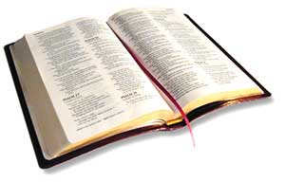
Authority
A Simple Study of How Authority Works In Religion

Slide 5
Authority
I. What Is Authority?
I. What Is Authority?

Slide 6
I. What Is Authority?
English: “The power to command, enforce laws, exact obedience, determine, or judge” (AHD, 142)
Greek (EXOUSIA): “Power of rule or government, the power of one whose will and commands must be obeyed by others e.g. Matt. 28:18…” (Vines I:89)
Inherent
Because of who one is
God
I have over my money
Delegated
Received from one in authority
Given to man by God
You spend my money

Slide 7
Authority
I. What Is Authority?
I. What Is Authority?
II. God Has Authority Over Man
II. God Has Authority Over Man

Slide 8
II. God Has Authority Over Man
Because He Is God
God (Exo. 3:14; Rev. 4:8)
Creator (Gen. 1:1; Heb. 3:4)
Infinite wisdom (Isa. 55:8-9)
Has all authority (Mt. 28:18)
Word Is Authoritative
Inspired (2 Tim. 3:16-17)
Violation = Sin (1 Jno. 3:4)
Taught w/ auth. (Tit. 2:15)
Can’t alter (Rev. 22:18-19)
Judged by it (Jno. 12:48)

Slide 9
Authority
I. What Is Authority?
I. What Is Authority?
II. God Has Authority Over Man
II. God Has Authority Over Man
III. The Need For Authority
III. The Need For Authority

Slide 10
III. The Need For Authority
A. The Order of Authority (1 Cor. 11:3)

Slide 11
1 Cor 11:3
“But I want you to know that the head of every man is Christ, the head of woman is man, and the head of Christ is God.”
God
(Father)
Christ
(son)
Man
Woman

Slide 12
III. The Need For Authority
A. The Order of Authority (1 Cor. 11:3)
B. Man Is Not His Own Authority
1. Jer. 10:23 – not to direct his own steps
2. Prov. 14:12 – way that seems right…

Slide 13
III. The Need For Authority
A. The Order of Authority (1 Cor. 11:3)
B. Man Is Not His Own Authority
C. Following Authority
1. Cain & Abel (Gen. 4)

Slide 14
Gen 4:3-5
3 And in the process of time it came to pass that Cain brought an offering of the fruit of the ground to the LORD.
4 Abel also brought of the firstborn of his flock and of their fat. And the LORD respected Abel and his offering,
5 but He did not respect Cain and his offering. And Cain was very angry, and his countenance fell.

Slide 15
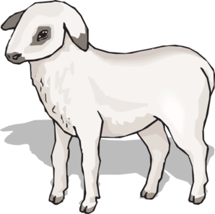
Cain
Abel
Offering:
“Fruit of ground”
Offering:
“firstborn of his flock”
Lord
Did Not Respect
Lord
Respected
Not: “By Faith”
“By Faith”
(Heb. 11:4)
Word of God
(Rom. 10:17)

Slide 16
III. The Need For Authority
A. The Order of Authority (1 Cor. 11:3)
B. Man Is Not His Own Authority
C. Following Authority
1. Cain & Abel (Gen. 4)
2. Nadab & Abihu (Lev. 10:1-2)

Slide 17
Lev 10:1-2
1 Then Nadab and Abihu, the sons of Aaron, each took his censer and put fire in it, put incense on it, and offered profane fire before the LORD, which He had not commanded them.
2 So fire went out from the LORD and devoured them, and they died before the LORD.
“…offered unauthorized fire…” (NIV)

Slide 18
Authority
I. What Is Authority?
I. What Is Authority?
II. God Has Authority Over Man
II. God Has Authority Over Man
III. The Need For Authority
III. The Need For Authority
IV. Must Have Bible Authority
IV. Must Have Bible Authority

Slide 19
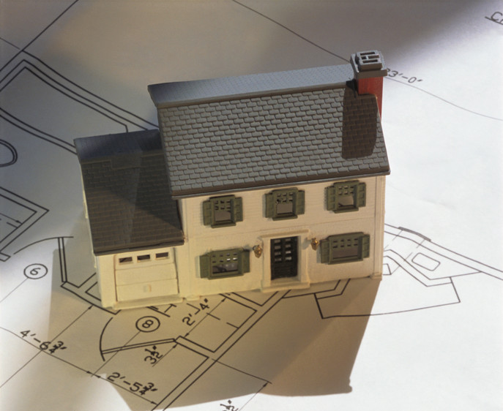
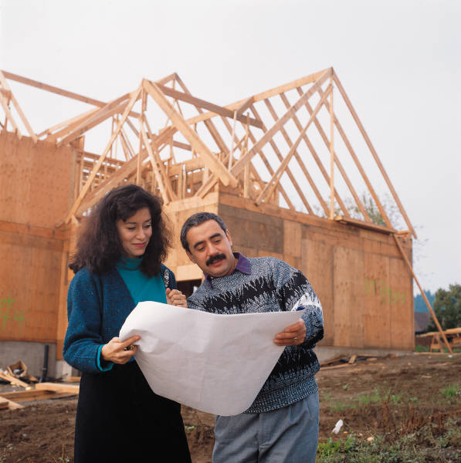
IV. We Must Have Bible Authority
God Has A Pattern
Hebrews 8:5
Then This
If This
Pattern
Model
Real

Slide 20
IV. We Must Have Bible Authority
Do all in name of Christ (Col. 3:17)

Slide 21
Col 3:17
17 And whatever you do in word or deed, do all in the name of the Lord Jesus, giving thanks to God the Father through Him.
“Open up in the name of the law!”
Acts 4:7
And when they had set them in the midst, they asked, "By what power or by what name have you done this?
Authority

Slide 22
IV. We Must Have Bible Authority
Do all in name of Christ (Col. 3:17)
Abide within the doctrine of Christ (2 John 9)

Slide 23
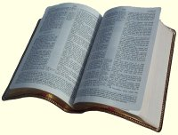
2 John 9
Whoever transgresses and does not abide in the doctrine of Christ does not have God. He who abides in the doctrine of Christ has both the Father and the Son.
Doctrine
of
Christ
Doctrine
Practice
ASV
Whosoever goeth onward and abideth not in the teaching of Christ…

Slide 24
IV. We Must Have Bible Authority
Do all in name of Christ (Col. 3:17)
Abide within the doctrine of Christ (2 John 9)
Christ is head of the church (Eph. 1:22-23; 5:23-24)
If not, can do anything!

Slide 25
Authority
I. What Is Authority?
I. What Is Authority?
II. God Has Authority Over Man
II. God Has Authority Over Man
III. The Need For Authority
III. The Need For Authority
IV. Must Have Bible Authority
IV. Must Have Bible Authority
V. How Authority Is Established
V. How Authority Is Established

Slide 26
V. How Authority Is Established
John 13:34-35
34 A new commandment I give to you, that you love one another; as I have loved you, that you also love one another.
35 By this all will know that you are My disciples, if you have love for one another."
1. Command /
Direct Statement
2. Approved
Example
3. Necessary
Inference

Slide 27
V. How Authority Is Established
Acts 15
Command / Statement
VV. 13-21 – James appealed to direct statement from Amos 9
Approved Example
V. 12 – Paul & Barnabas appealed to example of their work & miracles
Necessary Inference
VV. 7-11 – Peter appealed to events at Cornelius’ house – infers…

Slide 28
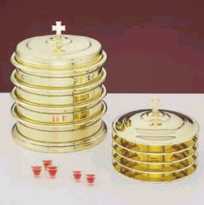
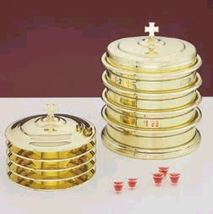
V. How Authority Is Established
Illustrated with Lord’s Supper
Command / Statement
Observance
(1 Cor. 11:23-24)
Approved Example
Time of Observance
(Acts 20:7)
Necessary Inference
Frequency of Observance
(Acts 20:7)

Slide 29
Authority
I. What Is Authority?
I. What Is Authority?
II. God Has Authority Over Man
II. God Has Authority Over Man
III. The Need For Authority
III. The Need For Authority
IV. Must Have Bible Authority
IV. Must Have Bible Authority
V. How Authority Is Established
V. How Authority Is Established
VI. Applying Bible Authority
VI. Applying Bible Authority

Slide 30
A. Generic & Specific Authority
When A Command
Is Left In The
Generic
Can Choose Any
Specific
Within That Generic
When A Command
Is
Specific
Can Not Choose Any
Other Specific
Within That Generic
Generic: Wood
Specific:
Cedar, Oak, Walnut,
Pine, Gopher, Hickory
Specified: Gopher
Eliminates:
Cedar, Oak, Walnut,
Pine, Hickory, etc.

Slide 31
A. Generic & Specific Authority
Command | Generic | Specific
Buy me a canned drink | Cola | Pepsi

Slide 32
A. Generic & Specific Authority
Command | Generic | Specific
Buy me a canned drink | Cola | Pepsi
Build ark - Gen. 6:14 | Wood | Gopher

Slide 33
A. Generic & Specific Authority
Command | Generic | Specific
Buy me a canned drink | Cola | Pepsi
Build ark - Gen. 6:14 | Wood | Gopher
Wash 7 Times - 2 Kings 5 | River | Jordan

Slide 34
A. Generic & Specific Authority
Command | Generic | Specific
Buy me a canned drink | Cola | Pepsi
Build ark - Gen. 6:14 | Wood | Gopher
Wash 7 Times - 2 Kings 5 | River | Jordan
Offer – Lev. 14:12-13 | Animal | Lamb

Slide 35
A. Generic & Specific Authority
Command | Generic | Specific
Buy me a canned drink | Cola | Pepsi
Build ark - Gen. 6:14 | Wood | Gopher
Wash 7 Times - 2 Kings 5 | River | Jordan
Offer – Lev. 14:12-13 | Animal | Lamb
Praise – Eph. 5:19 | Music | Sing

Slide 36
Singing
If God had said: “Music”
X
X
X
Sing
Instrum.
Hum
Whistle
Sing

Slide 37
B. Aids & Additions
Aid
Expedites command
Doing nothing more
No addition
Addition
Another element
Doing more than
commanded

Slide 38
B. Aids & Additions
An Addition Involves Another Element Being Added!
Command | Aid | Addition
Buy Me A Pepsi | Car, sack, cooler | Sprite, RC, etc.

Slide 39
B. Aids & Additions
An Addition Involves Another Element Being Added!
Command | Aid | Addition
Buy Me A Pepsi | Car, sack, cooler | Sprite, RC, etc.
Eat Bread – 1 Cor. 11 | Table, plates … | Jam, beef, cola

Slide 40
B. Aids & Additions
An Addition Involves Another Element Being Added!
Command | Aid | Addition
Buy Me A Pepsi | Car, sack, cooler | Sprite, RC, etc.
Eat Bread – 1 Cor. 11 | Table, plates … | Jam, beef, cola
Baptize – Matt. 28:19 | Baptistry, heater | Sprinkling

Slide 41
B. Aids & Additions
An Addition Involves Another Element Being Added!
Command | Aid | Addition
Buy Me A Pepsi | Car, sack, cooler | Sprite, RC, etc.
Eat Bread – 1 Cor. 11 | Table, plates … | Jam, beef, cola
Baptize – Matt. 28:19 | Baptistry, heater | Sprinkling
Build an ark – Gen. 6:14 | Tool, Animal | Oak, Cedar

Slide 42
B. Aids & Additions
An Addition Involves Another Element Being Added!
Command | Aid | Addition
Buy Me A Pepsi | Car, sack, cooler | Sprite, RC, etc.
Eat Bread – 1 Cor. 11 | Table, plates … | Jam, beef, cola
Baptize – Matt. 28:19 | Baptistry, heater | Sprinkling
Build an ark – Gen. 6:14 | Tool, Animal | Oak, Cedar
Contribute – 1 Cor. 16 | Basket, Account | Mon. / Sat.

Slide 43
B. Aids & Additions
An Addition Involves Another Element Being Added!
Command | Aid | Addition
Sing – Eph. 5:19 | Books, Tuner | Instrumental Music

Slide 44
C. The Silence of God
“God did not say not to”
“There is no passage that says ‘Thou shalt not…”
“Where is the passages that says it is wrong to…?”
Common Thought:
Silence of God gives permission

Slide 45
C. The Silence of God
1 Cor. 4:6 – forbidden to go beyond things written
Col. 2:22-23 – will worship (kjv)
Will worship = according to commandments of men
“voluntarily adopted worship, whether unbidden or forbidden” (W. E. Vine)
Any Passage That Says We Must Have Authority – Says We Must Respect God’s Silence!

Slide 46
C. The Silence of God
X
Two Mindsets
Permissive
At liberty to do what
is not
condemned
Prohibitive
Forbidden to act
Without authority
Heb. 7:14
For it is evident that our Lord arose from Judah, of which tribe Moses spoke nothing concerning priesthood

Slide 47
God Did Not Say Not To:
Ice Cream with the Lord’s Supper
Handle snakes as an act of worship
Church sponsored sports
Offer a bull or lamb as sacrifice
Count beads as an act of worship
Mechanical Instrum. of music in worship
Church to be in secular business

Slide 48
Suppose Someone Sends You To The Store
“Go buy me a gallon of milk & a box of cereal.”
Inherent Authority: One who owns the money
Delegated Authority: You have the authority to spend it
Only
Authorized To
Buy:
Milk & Cereal
“Did not say, ‘Don’t buy candy’”
“Did not say, ‘Don’t buy meat’”
“Did not say, ‘Don’t buy colas’”
“Did not say, ‘Don’t buy magazines’”

Slide 49
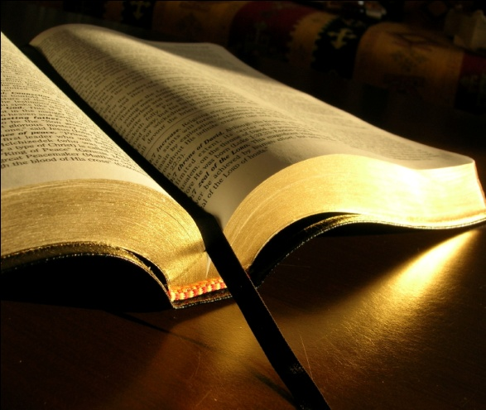
Bible
Authority
What we do in worship (sing or play)
What we do as a church (support organ.)
Who has a right to remarry (MDR controversy)
Role of elders & deacons (what they do)

Slide 50
Bible
Authority
Learned
Principle
Not Learned
Application
Learned
Application
Not Learned
Principle

Slide 51
Authority
I. What Is Authority?
I. What Is Authority?
II. God Has Authority Over Man
II. God Has Authority Over Man
III. The Need For Authority
III. The Need For Authority
IV. Must Have Bible Authority
IV. Must Have Bible Authority
V. How Authority Is Established
V. How Authority Is Established
VI. Applying Bible Authority
VI. Applying Bible Authority

