Slide 2
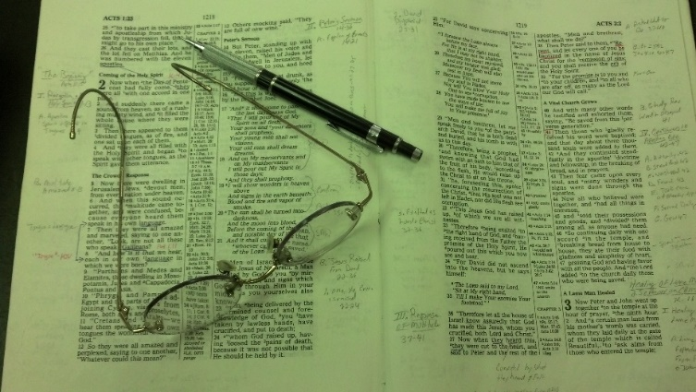
Topics
Sunday AM – Selling and Stirring
Sunday PM – The Peace of God
Monday – The Conversion of 3,000
Tuesday – The Seduction of Joseph
Wednesday – The Wayward Son Comes Home

Slide 3
Acts 27:22-25
22 And now I urge you to take heart, for there will be no loss of life among you, but only of the ship.
23 For there stood by me this night an angel of the God to whom I belong and whom I serve,
24 saying, 'Do not be afraid, Paul; you must be brought before Caesar; and indeed God has granted you all those who sail with you.'
25 "Therefore take heart, men, for I believe God that it will be just as it was told me.
Trust
Confidence
Dependence
Reliance

Slide 4
Heb 11:6
6 But without faith it is impossible to please Him, for he who comes to God must believe that He is, and that He is a rewarder of those who diligently seek Him.
Believe
In
God
Not
The
Same
Believe
God

Slide 5
Acts 1:1
1 The former account I made, O Theophilus, of all that Jesus began both to do and teach,
Must Accept:
What Jesus
Did
(Believe in Him)
What Jesus
Taught
(Believe Him)

Slide 6
John 20:30-31
20 And truly Jesus did many other signs in the presence of His disciples, which are not written in this book;
31 but these are written that you may believe that Jesus is the Christ, the Son of God, and that believing you may have life in His name.
Believe
Christ
Believe
In
Christ

Slide 7
1 John 5:10
10 He who believes in the Son of God has the witness in himself; he who does not believe God has made Him a liar, because he has not believed the testimony that God has given of His Son.
Believe God = believing testimony of God

Slide 8
Believe
In
God
Believe
God
The Challenge:
Merely
Both

Slide 9
Believing
God

Slide 10
Believing God
Those Who Faced The Challenge

Slide 11
Those Who Faced The Challenge
Believed in God & Believed God
Noah (Heb. 11:7; Gen. 6:22)
Abraham (Rom. 4:16-21)
Hannah (1 Sam. 1:1-18)
Hezekiah (2 Kings 18:5-6)
Ezra (Ezra 8:22)
Joseph (Matt. 1:18-25; 2:13-14)
Paul (Acts 27:25)

Slide 12
Those Who Faced The Challenge
Believed in God & Believed God
Believed in God – not Believe God
Moses (Exo. 3:11, 13; 4:1, 10; Num. 20:12)
Gideon (Judges 6:11-27)
Habakkuk (Hab. 1:12-ff)
Zacharias (Luke 1:6-25)
Peter (Matt. 26:31-35)

Slide 13
Believing God
Those Who Faced The Challenge
Your Challenge

Slide 14
Your Challenge
Believe in God
Believe that He exist – Real! (Heb. 11:6a)
Believe that He is creator of universe (Psa. 33:6-9)
Believe that Jesus is Son of God (John 8:24)
Believe that salvation is through Christ (Acts 4:12)
Believe that Jesus was raised from dead (Rom. 1:4)
Believe Bible is God’s revelation (2 Tim. 3:16-17)
Ready to Defend
Our Faith
Against All Challenges!

Slide 15
Your Challenge
Believe in God
Do You Really Believe God?
He controls world & nations (Dan. 4:25; Rev. 4)?
He hears & answers prayer (1 Pet. 3:12)?
Respect & obey parents (Eph. 6:1-4; Col. 3:20)?
How raise child – how turn out (Prov. 22:6)?
Discipline works (1 Cor. 5; 2 Cor. 2)?
Not allow tempted greater than can bear (1 Cor. 10:13)?
Can obey any command, etc. (Phil. 4:13)?
The power is in the word (Rom. 1:16)?
Association with evil corrupts (1 Cor. 15:33)?
Could return at any time (2 Pet. 3:10)?

Slide 16
Your Challenge
Believe in God
Do You Really Believe God?
Do Believe God Enough to Obey?
One thing to believe in God
Another thing to believe God
Even another to act upon that faith! (i.e. Moses)
Jeremiah
Preached that Israel would return (Jer. 25:11)
Believed that Israel would return
Bought a field as a promise (Jer. 32)

Slide 17
Believing God
Those Who Faced The Challenge
Your Challenge

